Slide 1


DSOB3512
COVID-19 HOSPITALIZATIONS (ICU OR MED/SURG), MORTALITY BY AGE GROUPS AND TESTS OVER TIME
SQL AND DATABASE

Slide 2

DSOB3512
The COVID-19 pandemic has significantly strained healthcare systems worldwide, including San Francisco, where hospitals faced an unprecedented surge in ICU (intensive care) and Med/Surg (acute care) patient counts. This report examines hospitalization trends, mortality data, and testing outcomes across various years to identify correlations and inform future preparedness. Key findings include notable spikes in ICU admissions during January 2021, the high vulnerability of older populations (80+ age group), and the correlation between rising positive test counts and increased hospitalizations and mortality. These insights underscore the critical need for scalable healthcare infrastructure, targeted interventions for vulnerable populations, and robust testing programs to mitigate future healthcare crises.
Executive Summary

Slide 3

DSOB3512
The COVID-19 pandemic disrupted global healthcare systems, exposing vulnerabilities and challenging hospital capacities. In San Francisco, like many other urban centers, the pressure on ICU and Med/Surg departments highlighted the critical need for data-driven decision-making. This report evaluates hospitalization and mortality trends over five years (2020–2024) to understand the relationship between testing outcomes, patient counts, and mortality rates, focusing on periods of significant changes.
Introduction

Slide 4
DSOB3512
Problem Definition: COVID-19 Impact on Hospitalization and Mortality in San Fransisco
The COVID-19 pandemic significantly impacted health systems globally, and understanding how it affected hospitalizations and mortality in a specific region is crucial for future preparedness. In San Francisco, as with many urban centres, the pressure on healthcare services, especially in ICU and Med/Surg departments, led to a rapidly evolving situation. This analysis aims to explore how hospitalization trends and mortality patterns evolved in San Francisco, with a focus on demographic variations and the factors that influenced these trends.

Slide 5



DSOB3512
Objectives
To analyze hospitalization trends in ICU and Med/Surg departments in San Francisco hospitals
To explore mortality patterns across different age groups and years.
To correlate hospitalization rates, mortality trends, and test outcomes to inform healthcare strategies.

Slide 6

DSOB3512
Overarching Questions
How did COVID-19 hospitalization trends evolve in San Francisco, and what factors influenced patient counts across ICU and Med/Surg departments?
01
What were the mortality patterns for COVID-19 patients in San Francisco hospitals, and how did these vary by demographic group over time?
02

Slide 7
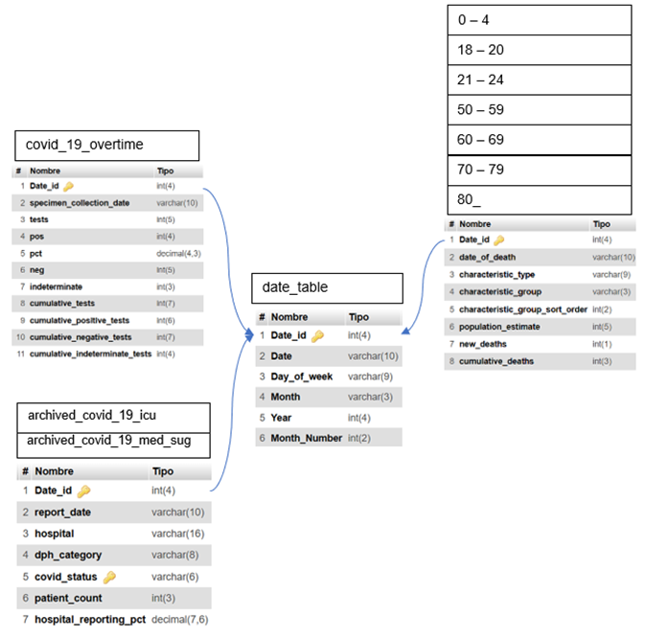
DSOB3512
Database Scheme
02

Slide 8
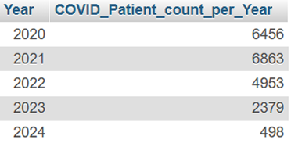
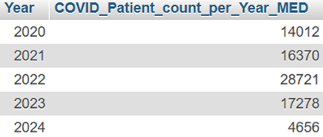
DSOB3512
Hospitalization Data Analysis
What trends emerged in COVID-19 patient counts within ICU and Med/Surg departments at San Francisco hospitals?
We want to compare the trends of the patient count across the years for patients that were in intensive care (ICU) and acute care (Med/Surg), for COVID-positive patients
Results
Notes:
Comments: We can observe from the results that the number of patients in acute care was higher than patients in intensive care. 2021 was the year with the greatest number of patients in intensive care, while 2022 was the year with the greatest number of patients in acute care. Despite that the number of patients in acute care was increasing, the number of patients in a critical situation was not.

Slide 9
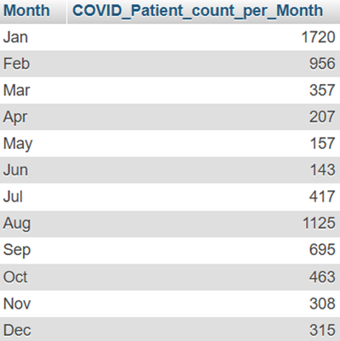
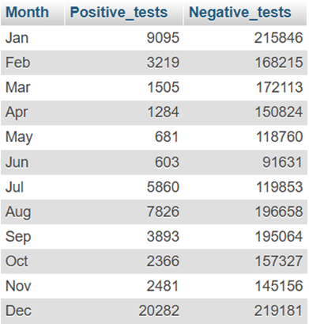
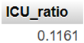
DSOB3512
Hospitalization Data Analysis
Are there identifiable periods with significant changes in hospitalizations for patients in intensive care (ICU)?
We will focus on year 2021 since that was the year with the greatest number of patients hospitalized.
Results
Notes:
Comments: From the results we can observe that January is the month with the greatest number of ICU hospitalizations and the number goes down until August when there is a rebound two months after the lowest number of hospitalizations during the year.
We checked the number of positive and negative tests for the same period.
We can see on that the number of positive tests has the same behaviour as the number of patients hospitalized in ICU.
And from all positive tests during 2021, 11.6% of those people needed ICU.
To summarize this part, based on the spikes in ICU admissions noted in January 2021, hospitals should establish plans for quickly expanding ICU capacity during critical periods. This could involve converting Med/Surg beds to ICU temporarily or setting up additional ICU units.
Since 2022 showed an increase in Med/Surg hospitalizations, it’s essential to ensure that acute care units can handle a high patient load without requiring ICU care. Invest in scalable infrastructure that allows for a rapid shift between care levels.

Slide 10
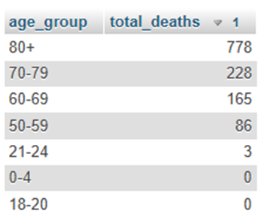
DSOB3512
Mortality Data Analysis in San Francisco Hospitals
How did COVID-19-related deaths among patients vary across age groups and other demographic characteristics in San Francisco hospitals?
Results
Notes:
Comments: We can observe that older groups had more deaths.

Slide 11
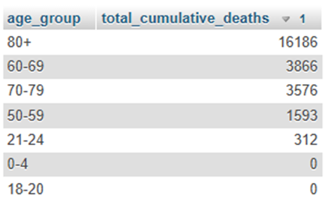
DSOB3512
Mortality Data Analysis in San Francisco Hospitals
What patterns can be observed in the progression of cumulative COVID-19 deaths?
Results
Notes:
Comments: The distribution of total cumulative COVID-19 deaths across age groups in 2020 highlights a significant disparity in mortality rates. The 80+ age group experienced the highest number of cumulative deaths, with 16,186 deaths, underscoring their vulnerability to severe outcomes of the virus. This is followed by the 60-69 (3,866 deaths) and 70-79 (3,576 deaths) age groups, indicating elevated risks among older adults. In contrast, younger age groups, such as 21-24 and below, recorded minimal or no cumulative deaths, as seen with 312 deaths in the 21-24 age group and zero deaths in the 0-4 and 18-20 groups. These patterns emphasize the critical need for targeted protective measures for older populations to mitigate the mortality burden of the pandemic.

Slide 12
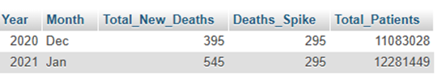
DSOB3512
Mortality Data Analysis in San Francisco Hospitals
Were there specific periods where mortality rates spiked, and do these correspond to shifts in hospitalization data?
Results
Notes:
Comments:
The table result highlights a significant observation in the analysis of mortality data during the COVID-19 pandemic. In December 2020, the total number of new deaths was 395, with a noticeable spike of 295 deaths compared to previous months. This trend continued into January 2021, where new deaths increased further to 545, maintaining the same spike of 295. This indicates a critical period of increased mortality, potentially corresponding to heightened COVID-19 cases or hospitalizations during this time. The accompanying increase in total patients, from approximately 11 million in December 2020 to over 12 million in January 2021, further supports the notion of increased healthcare burden during this period. This correlation between rising patient numbers and mortality spikes could indicate healthcare system strain or the impact of worsening pandemic conditions.

Slide 13
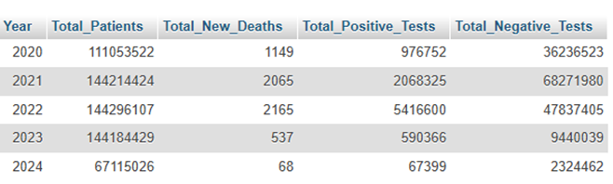
DSOB3512
Mortality Data Analysis in San Francisco Hospitals
Were there specific periods where mortality rates spiked, and do these correspond to shifts in hospitalization data?
Results
Notes:
Comments: The table presents an integrated yearly analysis of hospitalization and mortality trends from 2020 to 2024. It shows a steady increase in total patients from 2020 to 2023, with a significant drop in 2024. The total new deaths peaked in 2022, aligning with the highest numbers of positive tests in the same year, which suggests a correlation between increased positive cases and mortality rates. Conversely, the total negative tests were highest in 2023, indicating improved testing efforts, though the deaths significantly decreased that year. This trend highlights potential improvements in healthcare management and COVID-19 response over time, particularly after 2022.

Slide 14
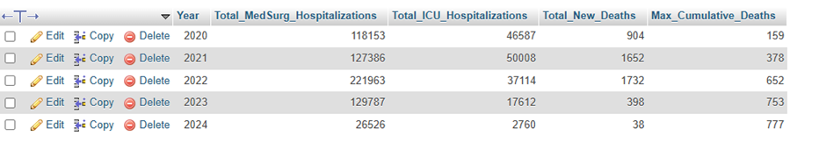
DSOB3512
Integrated Analysis of Hospitalization and Mortality
Can relationships between ICU and Med/Surg hospitalization rates and mortality trends be identified?
Results
Notes:
Comments: The table provides an integrated yearly analysis of hospitalizations (Med/Surg and ICU) and mortality trends from 2020 to 2024. It highlights the total number of hospitalizations in Med/Surg and ICU facilities alongside total new deaths and the maximum cumulative deaths recorded each year. The data shows that 2022 had the highest Med/Surg hospitalizations (221,963) and ICU hospitalizations (37,114), correlating with a significant number of new deaths (1,732) and cumulative deaths (652). Conversely, 2024 shows a sharp decline in hospitalizations and new deaths, indicating a reduction in severe COVID-19 cases or improved management over time. These trends suggest a relationship between hospitalization rates and mortality, with years of high hospitalizations typically aligning with higher mortality figures.

Slide 15
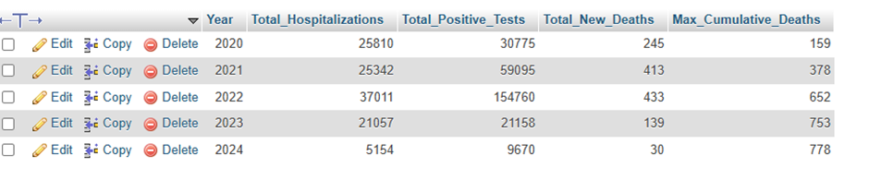
DSOB3512
Integrated Analysis of Hospitalization and Mortality
How do changes in patient count within San Francisco hospitals correlate with mortality trends over time?
Results
Notes:
Comments: The table illustrates the yearly relationship between total hospitalizations, positive tests, new deaths, and cumulative deaths, providing insight into the correlation between these metrics. In 2020 and 2021, a clear pattern emerges where an increase in positive tests correlates with higher hospitalizations and new deaths, indicating the direct impact of rising COVID-19 cases on hospital burden and mortality. By 2022, while positive tests surged significantly, hospitalizations and deaths showed a relatively smaller increase, potentially reflecting improved medical responses or vaccine impacts. In 2023 and 2024, both positive tests and hospitalizations decreased sharply, and new deaths followed the trend, though cumulative deaths continue to rise slightly due to the residual impact of earlier periods. This suggests that while case management and preventive measures have improved, the lingering effects of severe infections still contribute to overall mortality trends.

Slide 16
DSOB3512
This analysis highlights the dynamic interplay between hospitalization rates, testing outcomes, and mortality trends during the COVID-19 pandemic in San Francisco. The surge in ICU and Med/Surg hospitalizations during 2021 and 2022 aligned closely with increases in positive tests and new deaths. However, the later decline in hospitalizations and deaths suggests improved public health measures and vaccine effectiveness. Notably, older age groups were disproportionately affected, emphasizing the need for targeted interventions for vulnerable populations
Conclusion

Slide 17
DSOB3512
Recommendations
Scalable Healthcare Infrastructure:
Hospitals should develop flexible capacity plans, enabling rapid conversion of Med/Surg beds to ICU units during critical periods.
Data-Driven Decision-Making:
Regularly update predictive models based on hospitalization and mortality data to anticipate healthcare needs during potential future waves
01
04
Targeted Interventions:
Focus on protecting high-risk groups, particularly individuals aged 60 and above, through vaccination, booster programs, and tailored healthcare strategies.
02
Public Awareness Campaigns:
Educate communities on preventive measures and the importance of early testing and treatment to reduce severe outcomes.
05
Expanded Testing and Monitoring:
Continue investing in large-scale testing and surveillance to detect trends early and implement timely interventions
03

Slide 18
DSOB3512
Queries
SELECT dates.Year, SUM(ICU.patient_count) AS COVID_Patient_count_per_Year
FROM archived_covid_19_icu AS ICU
LEFT JOIN date_table AS dates
ON ICU.Date_id = dates.Date_id
WHERE ICU.covid_status = "COVID+"
GROUP BY dates.Year
SELECT dates.Year, SUM(MED.patient_count) AS COVID_Patient_count_per_Year_MED
FROM archive_covid_19_med_sug AS MED
LEFT JOIN date_table AS dates
ON MED.Date_id = dates.Date_id
WHERE MED.covid_status = "COVID+"
GROUP BY dates.Year
SELECT
characteristic_group AS age_group,
SUM(new_deaths) AS total_deaths
FROM
combined_mortality
GROUP BY
characteristic_group
ORDER BY
total_deaths DESC;
CREATE TABLE combined_mortality AS
SELECT * FROM 0_4
UNION ALL
SELECT * FROM 18_20
UNION ALL
SELECT * FROM 21_24
UNION ALL
SELECT * FROM 50_59
UNION ALL
SELECT * FROM 60_69
UNION ALL
SELECT * FROM 60_69
UNION ALL
SELECT * FROM 70_79
UNION ALL
SELECT * FROM 80_
SELECT dates.Year, SUM(ICU.patient_count) AS COVID_Patient_count_per_Year
FROM archived_covid_19_icu AS ICU
LEFT JOIN date_table AS dates
ON ICU.Date_id = dates.Date_id
WHERE ICU.covid_status = "COVID+"
GROUP BY dates.Year
SELECT dates.Year, SUM(MED.patient_count) AS COVID_Patient_count_per_Year_MED
FROM archive_covid_19_med_sug AS MED
LEFT JOIN date_table AS dates
ON MED.Date_id = dates.Date_id
WHERE MED.covid_status = "COVID+"
GROUP BY dates.Year

Slide 19
DSOB3512
Queries
SELECT
characteristic_group AS age_group,
SUM(cumulative_deaths) AS total_cumulative_deaths
FROM
combined_mortality
WHERE
YEAR = 2020
GROUP BY
characteristic_group
ORDER BY
total_cumulative_deaths DESC;
SELECT
dt.Date_id,
dt.Date,
dt.Month,
dt.Year,
dt.Day_of_week,
'ICU' AS Hospital_Type,
icu.patient_count,
cm.new_deaths,
cm.cumulative_deaths
FROM date_table dt
JOIN archived_covid_19_icu icu ON dt.Date_id = icu.Date_id
LEFT JOIN combined_mortality cm ON dt.Date_id = cm.Date_id
UNION ALL
SELECT
dt.Date_id,
dt.Date,
dt.Month,
dt.Year,
dt.Day_of_week,
'AgeGroup' AS Hospital_Type,
cm.population_estimate AS patient_count,
cm.new_deaths,
cm.cumulative_deaths
FROM date_table dt
JOIN combined_mortality cm ON dt.Date_id = cm.Date_id
)
WITH CombinedData AS (
SELECT
dt.Date_id,
dt.Date,
dt.Month,
dt.Year,
dt.Day_of_week,
'MedSurg' AS Hospital_Type,
ms.patient_count,
cm.new_deaths,
cm.cumulative_deaths
FROM date_table dt
JOIN archive_covid_19_med_sug ms ON dt.Date_id = ms.Date_id
LEFT JOIN combined_mortality cm ON dt.Date_id = cm.Date_id
UNION ALL

Slide 20
DSOB3512
Queries
WITH CombinedData AS (
SELECT
dt.Date_id,
dt.Date,
dt.Year,
dt.Day_of_week,
'MedSurg' AS Hospital_Type,
ms.patient_count,
cm.new_deaths,
cm.cumulative_deaths,
co.pos AS positive_tests,
co.neg AS negative_tests
FROM date_table dt
JOIN archive_covid_19_med_sug ms ON dt.Date_id = ms.Date_id
LEFT JOIN combined_mortality cm ON dt.Date_id = cm.Date_id
LEFT JOIN covid_19_overtime co ON dt.Date_id = co.Date_id
UNION ALL
SELECT
dt.Date_id,
dt.Date,
dt.Year,
dt.Day_of_week,
'ICU' AS Hospital_Type,
icu.patient_count,
cm.new_deaths,
cm.cumulative_deaths,
co.pos AS positive_tests,
co.neg AS negative_tests
FROM date_table dt
JOIN archived_covid_19_icu icu ON dt.Date_id = icu.Date_id
LEFT JOIN combined_mortality cm ON dt.Date_id = cm.Date_id
LEFT JOIN covid_19_overtime co ON dt.Date_id = co.Date_id
MonthlyData AS (
SELECT
Year,
Month,
SUM(patient_count) AS Total_Patients,
SUM(new_deaths) AS Total_New_Deaths,
MAX(cumulative_deaths) AS Max_Cumulative_Deaths
FROM CombinedData
GROUP BY Year, Month
)
, MortalitySpikes AS (
SELECT
Year,
Month,
Total_New_Deaths,
LAG(Total_New_Deaths) OVER (ORDER BY Year, Month) AS Previous_Deaths,
Total_New_Deaths - LAG(Total_New_Deaths) OVER (ORDER BY Year, Month) AS Deaths_Spike
FROM MonthlyData
)
SELECT
ms.Year,
ms.Month,
ms.Total_New_Deaths,
ms.Deaths_Spike,
md.Total_Patients
FROM MortalitySpikes ms
LEFT JOIN MonthlyData md
ON ms.Year = md.Year AND ms.Month = md.Month
WHERE ms.Deaths_Spike > (SELECT AVG(Deaths_Spike) + 2 * STDDEV(Deaths_Spike) FROM MortalitySpikes)
ORDER BY ms.Year, ms.Month;

Slide 21
DSOB3512
Queries
UNION ALL
SELECT
dt.Date_id,
dt.Date,
dt.Year,
dt.Day_of_week,
'AgeGroup' AS Hospital_Type,
cm.population_estimate AS patient_count,
cm.new_deaths,
cm.cumulative_deaths,
co.pos AS positive_tests,
co.neg AS negative_tests
FROM date_table dt
JOIN combined_mortality cm ON dt.Date_id = cm.Date_id
LEFT JOIN covid_19_overtime co ON dt.Date_id = co.Date_id
)
, YearlyData AS (
SELECT
Year,
SUM(patient_count) AS Total_Patients,
SUM(new_deaths) AS Total_New_Deaths,
MAX(cumulative_deaths) AS Max_Cumulative_Deaths,
SUM(positive_tests) AS Total_Positive_Tests,
SUM(negative_tests) AS Total_Negative_Tests
FROM CombinedData
GROUP BY Year
)
SELECT
Year,
Total_Patients,
Total_New_Deaths,
Total_Positive_Tests,
Total_Negative_Tests
FROM YearlyData
ORDER BY Year;
WITH HospitalizationData AS (
SELECT
dt.Date_id,
dt.Date,
dt.Year,
'MedSurg' AS Hospital_Type,
ms.patient_count AS MedSurg_Hospitalizations,
0 AS ICU_Hospitalizations
FROM date_table dt
JOIN archive_covid_19_med_sug ms ON dt.Date_id = ms.Date_id
UNION ALL
SELECT
dt.Date_id,
dt.Date,
dt.Year,
'ICU' AS Hospital_Type,
0 AS MedSurg_Hospitalizations,
icu.patient_count AS ICU_Hospitalizations
FROM date_table dt
JOIN archived_covid_19_icu icu ON dt.Date_id = icu.Date_id
),
MortalityData AS (
SELECT
dt.Date_id,
dt.Date,
dt.Year,
cm.new_deaths,
cm.cumulative_deaths
FROM date_table dt
JOIN combined_mortality cm ON dt.Date_id = cm.Date_id
),

Slide 22
Queries
DSOB3512
WITH HospitalizationData AS (
SELECT
dt.Year,
SUM(ms.patient_count) AS Total_MedSurg_Hospitalizations,
0 AS Total_ICU_Hospitalizations
FROM date_table dt
JOIN archive_covid_19_med_sug ms ON dt.Date_id = ms.Date_id
GROUP BY dt.Year
UNION ALL
SELECT
dt.Year,
0 AS Total_MedSurg_Hospitalizations,
SUM(icu.patient_count) AS Total_ICU_Hospitalizations
FROM date_table dt
JOIN archived_covid_19_icu icu ON dt.Date_id = icu.Date_id
GROUP BY dt.Year
),
MortalityData AS (
SELECT
dt.Year,
SUM(cm.new_deaths) AS Total_New_Deaths,
MAX(cm.cumulative_deaths) AS Max_Cumulative_Deaths
FROM date_table dt
JOIN combined_mortality cm ON dt.Date_id = cm.Date_id
GROUP BY dt.Year
),
TestingData AS (
SELECT
dt.Year,
SUM(c19o.pos) AS Total_Positive_Tests
FROM date_table dt
JOIN covid_19_overtime c19o ON dt.Date_id = c19o.Date_id
GROUP BY dt.Year
),
CombinedData AS (
SELECT
h.Year,
SUM(h.Total_MedSurg_Hospitalizations) AS Total_MedSurg_Hospitalizations,
SUM(h.Total_ICU_Hospitalizations) AS Total_ICU_Hospitalizations,
m.Total_New_Deaths,
CombinedAnalysis AS (
SELECT
h.Year,
SUM(h.MedSurg_Hospitalizations) AS Total_MedSurg_Hospitalizations,
SUM(h.ICU_Hospitalizations) AS Total_ICU_Hospitalizations,
SUM(m.new_deaths) AS Total_New_Deaths,
MAX(m.cumulative_deaths) AS Max_Cumulative_Deaths
FROM HospitalizationData h
LEFT JOIN MortalityData m ON h.Date_id = m.Date_id
GROUP BY h.Year
)
SELECT
Year,
Total_MedSurg_Hospitalizations,
Total_ICU_Hospitalizations,
Total_New_Deaths,
Max_Cumulative_Deaths
FROM CombinedAnalysis
ORDER BY Year;

Slide 23
DSOB3512
Queries
m.Max_Cumulative_Deaths,
t.Total_Positive_Tests
FROM HospitalizationData h
LEFT JOIN MortalityData m ON h.Year = m.Year
LEFT JOIN TestingData t ON h.Year = t.Year
GROUP BY h.Year, m.Total_New_Deaths, m.Max_Cumulative_Deaths, t.Total_Positive_Tests
)
SELECT
Year,
Total_MedSurg_Hospitalizations + Total_ICU_Hospitalizations AS Total_Hospitalizations,
Total_Positive_Tests,
Total_New_Deaths,
Max_Cumulative_Deaths
FROM CombinedData
ORDER BY Year;

Slide 24

DSOB3512
THANK YOU
ABEL, PAUL, MARIA , PRASANNA

